Slide 1
INTERNSHIP REPORT
Abhijeet Mishra
Project Trainee,
Low Cost Automation, MHE Department,
Godrej & Boyce Mfg. Co. Ltd.
(26th March 18 – 30th June 18)

Slide 2
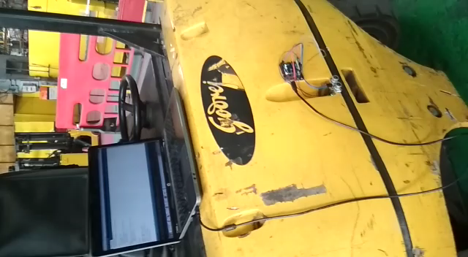
AUTOMATIC TURN-RADIUS MEASUREMENT SYSTEM
AIM: To calculate actual turn radius of forklifts automatically.
BEFORE: Workman walks around with the forklift and marks the path followed by forklift by dripping water along the path.
SOLUTION: Used ultrasonic sensors to completely automate the process. One only needs to turn the forklift. Easily mountable and detachable.
Prototype developed for less than Rs. 2000 and concept working. Developing casing for the same to be put in actual use.

Slide 3
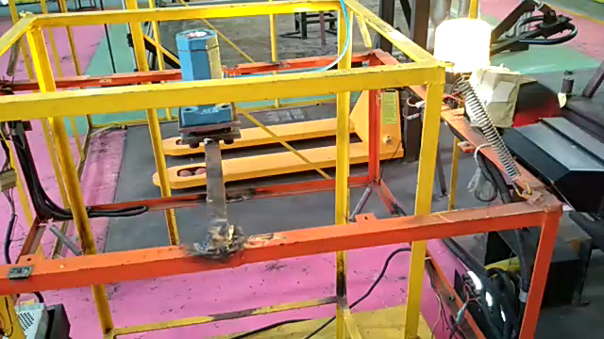
ELECTRIC COMPONENTS TEST SETUP VIBRATION
AIM: To vibrate the electrical components test jig to simulate real-world vibrations experienced by forklifts.
SOLUTION: Selected and procured pneumatic vibrator which is cost effective and can run continuously for weeks without heating/ wear and tear.
Cost effective mechanism to replace the motor – cam mechanism.
Currently operational. Provides higher acceleration than experienced in field.

Slide 4
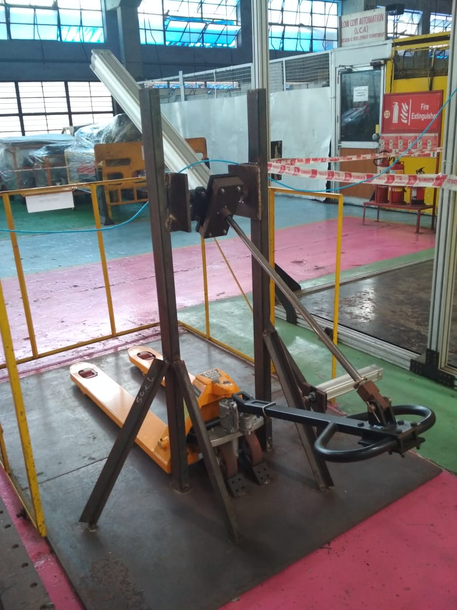
INDIGENOUS PALLET TRUCK TEST SETUP
AIM: To develop a test setup responsible for testing the life of indigenous hand pallet truck
SOLUTION: Designed and developed a setup which can continuously operate the hand pallet and simulate lowering and lifting of load. Used Pneumatic components to achieve desired solution. Can determine the number of cycles after which oil begins to leak in the setup.
Currently, mechanical construction is complete. Sensors scheduled to be delivered by 7th July, 2018 and system will be complete

Slide 5
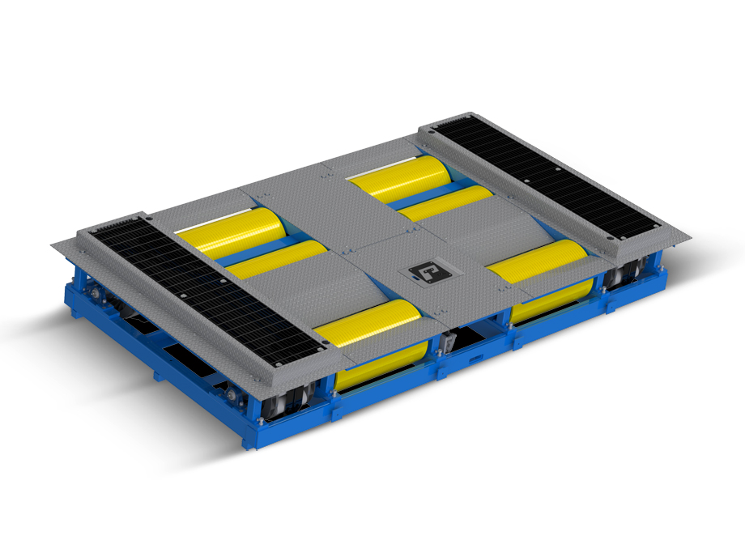
CHASSIS DYNAMOMETER
AIM: To select a chassis dynamometer for end of life and end of line testing.
SOLUTION: Conducted market research and finalized the two best dynamometer manufacturers in India. Compared and suggested the type of dynamometer to be used and submitted final request for quotation.
Currently, DMC is comparing options and finalizing the specifications of test setup.

Slide 6
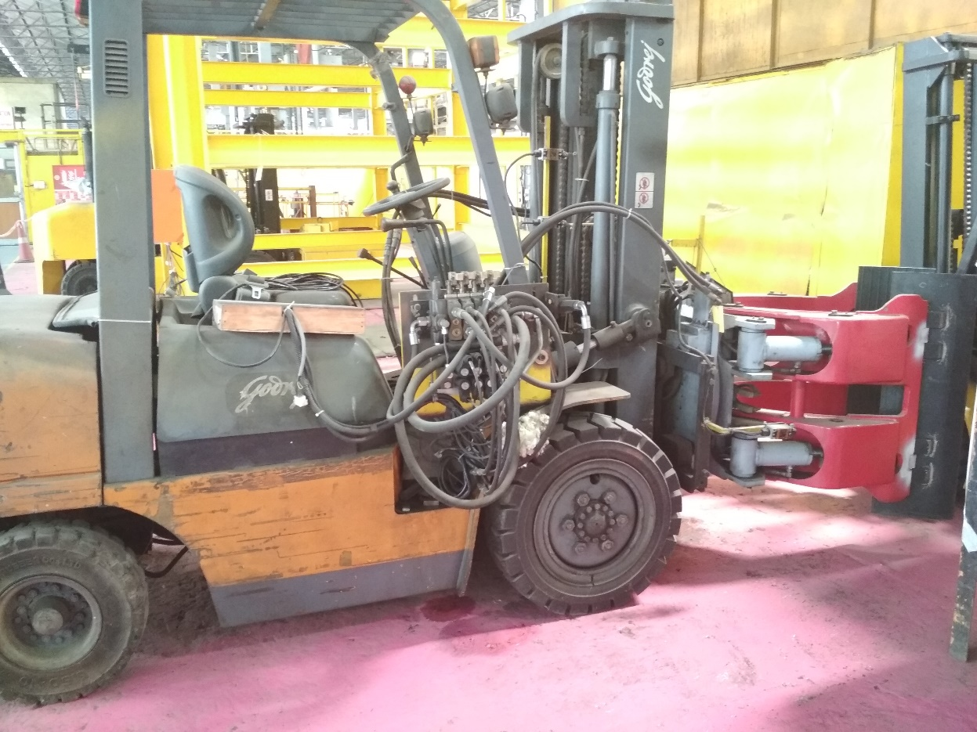
MOTOR FOR PAPER-ROLL-CLAMP TEST SETUP
AIM: Selection of motor for powering the hydraulic circuit to test the PRC developed in-house.
SOLUTION: Calculated the motor specifications for the circuit and found 25 HP motor to be suitable. Suggested the different options available and provided quotation.
Currently in Procurement phase.

Slide 7
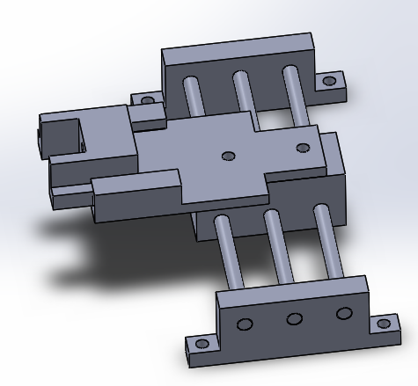
Front-Neutral-Reverse Switch Test Setup
AIM: To create a test setup to measure the life of FNR switch of provided by new supplier.
SOLUTION: Designed a system which is capable of performing the required motion continuously till failure occurs.
Currently CAD model has been developed and supplier of ball thread linear actuator has been finalized.

Slide 8
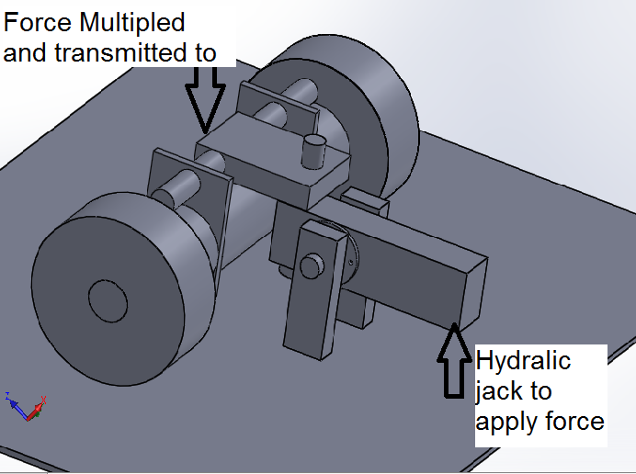
DRIVE TRAIN AXLE SETUP DESIGN
AIM: To design a system to test the failure of drive axle of Bravo and Neo forklifts.
SOLUTION: Designed a system which utilizes hydraulic jack to provide loading on axle rather than employing a 4-5 Ton metal weight. Thus reduced the cost of system drastically.
Currently, CAD model has been prepared which can be manufactured in-house.

Slide 9
OTHER MINI PROJECTS
Have started practice of using linear bearings in Pneumatic Pistons. These bearings absorb the perpendicular forces which cause the wearing of bushings inside the pneumatic cylinders. Thus, have reduced maintenance costs. Further, the setup, if purchased from supplier, costs more than Rs 10,000. Can be fabricated in-house for less than Rs. 2000, including material. Learnings, already implemented in another setup.
Created a template for ordering Pneumatic components. Now, if a pneumatic setup is required, one directly needs to only forward the template which includes all item codes, details and costs. (Kaizan)
Calibrated the 25 Ton load cell and have provided documentation as to how to calibrate it again, if need arises.

Slide 10
THANK YOU
I thank Godrej & Boyce for giving me the opportunity to work in a corporate environment in a field which I am very interested in.
I thank Mr. Anil Lingayat who supported me in this internship.
My special thanks to Mr. Shirzad Bhathena who gave me a free hand while working on my projects and encouraged me to look for out of the box solutions. He also supported me when my ideas did not work out as planned.

